Slide 1


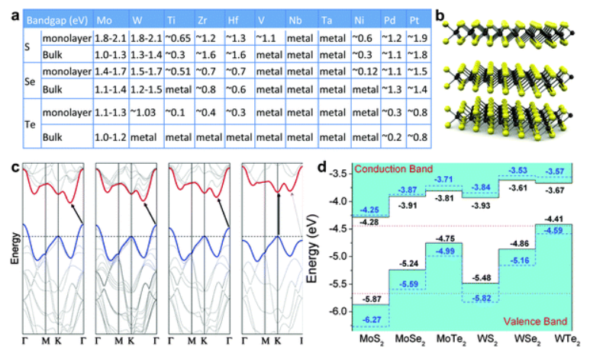
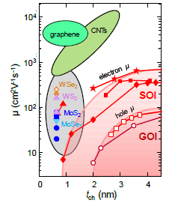
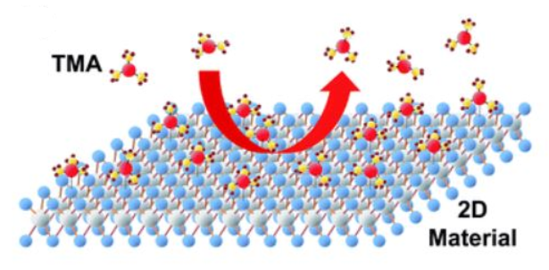

ENGR 241: ALD Process for Top-Gating 2D Materials
Akash Levy, Jung-Soo Ko
Mentors: J Provine, Michelle Rincon, Vijay Narasimhan
Stanford Nanofabrication Facility, Stanford University, Stanford, CA
AFM HERE
Introduction
2D materials → high mobility and little SCE when scaled (no dangling bonds at the surface)
2D TMDs→ Scalability, low off-state energy consumption, flexibility, large bandgap
Surface Characterization
Seed layer deposition (0.5, 1, 1.5, 2nm) on MoS₂ and ALD total of 5 and 10nm of alumina
Ellipsometry for seed layer thickness & AFM for roughness
Define # of ALD cycles based on oxidized alumina thickness
Conclusion
Seed layer deposition helps nucleation for ALD
Thicker seed layer smoothens the surface → conformal coverage
Seed layer seems to increase dielectric constant and decrease breakdown voltage (based on MIM structures)
Need more data to fully verify: will also test with hafnia
Mark location on chip first to measure on same flake
More accurate but possible PR residues
(a)
(b)
 | 5nm alumina (oxidized seed layer+ALD)
Seed layer (nm) | 0.5 | 1 | 1.5 | 2
RMS (nm) | 0.538 | 0.505 | 0.400 | 0.245
 | 10nm alumina (oxidized seed layer+ALD)
Seed layer (nm) | 0.5 | 1 | 1.5 | 2
RMS (nm) | 0.428 | 0.307 | 0.277 | 0.205
Benefit to SNF
Process flow for top-gated 2D devices
Recipe for ALD on 2D materials and samples w/ seed layer
Provide characterization results (electrical and surface imaging) regarding
Different seed layer thickness
Different seed layer material
(a) Bandgap (b) mobility trend of 2D TMDs [1, 2]
Challenges & Proposal
High-k needs to be stacked for CMOS compatibility
→ Use atomic layer deposition (ALD)
ALD on 2D materials is difficult due to lack of dangling bonds
Surface treatment is necessary for low EOT devices
Next Quarter Plan/Process
FET device process flow for I-V measurement
C-V difficult due to ultrathin channel
Different seed layer and ALD oxide combinations
Al, Hf, Zr
Various available oxides in Fiji
PEALD on 2D materials w/, w/o seed layer
Plasma may damage 2D materials
Seed layer deposition may protect from plasma damage
Electrical Characterization
(a)
(b)
Type
MIM Structure Doping: highly n-doped (phosphorus) Resistivity: very low (0.01-0.09 Ω cm)
MOS Structure Stockroom I-test wafer Doping: p-doped (boron) Resistivity: moderately low (0.1-0.9 Ω cm)
Seed layer (nm)
0.0
0.5
1.0
1.5
2.0
ALD (nm)
5
10
Proposal: Seed Layer Deposition prior to top gating
Seed layer on 2D TMDs helps nucleation for ALD growth
100nm
Gate Oxide
Al₂O₃ (ALD)
(a)
(b)
MoS2 Sample
Contact Pads (Litho & AJA)
HKMG Seed layer (AJA)
ALD(Fiji 1/2)
Gate Electrode (AJA)
Liftoff
Litho (S/D patterning)
S/D Electrode (AJA)
Liftoff
Litho (Gate Patterning)
Litho (Channel Patterning)
O₂ Plasma etch
(c)
Evaporated Seed Layer
AlO_{x} (Evaporated)
G
2D TMD
Native Oxide SiO₂ (1.5nm)
S
HKMG
D
SiO2
n++ Si
SiO2
Metal Oxide
Si
Seed layer
Oxidized seed layer
Oxidized Seed layer
SiO2
AJA
SiO2
Air
SiO2
Fiji
SiO2
(a) 2D FET device structure (b) 2D FET device process flow
Si
Si
Si
Si
References
[1] Duan et al. Chem. Soc. Rev., 2015, 44, 8859
[2] C. English, PhD Thesis, Stanford, Dec 2017
[3] Park et al. RSC Adv., 2017, 7, 884
(a) Non-uniform ALD on 2D materials [3], (b) AFM after ALD w/o seed layer (5nm left, 10nm right) on MoS₂ , (c) Proposed seed layer deposition process

